Slide 1

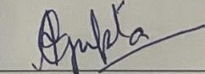
CERTIFICATE OF COMPLETION
This is to certify that <Name> pursuing degree < Organization> has successfully completed AI internship with us for a period of 1 month in April’26 , where the intern helped us in rolling out our AI strategy which included rollout of our custom AI toolkit including RAG models , automations and data analytics. We wish the intern all the best for a bright professional career
Corporate Trainer
Amit Kumar Gupta(Microsoft certified trainer)
Founder , Eklavya career initiative

